Slide 1
Cloud Computing

Slide 2
Agenda
What is Cloud Computing
Benefits of Cloud Computing
Types of Cloud
Cloud Providers
Service Models
Conclusion

Slide 3

What is Cloud Computing
Cloud computing is a model for delivering IT services over the internet, allowing on-demand access to resources like servers, storage, and applications
Key to the definition of Cloud Computing is “Cloud” itself. A cloud is a large group of interconnected computers

Slide 4

Benefits of Cloud Computing
Scalability: Easily adjust resources based on demand.
Cost-effectiveness: Pay-as-you-go pricing model.
Flexibility: Access resources from anywhere with an internet connection.
Reliability: High availability and redundancy.
Accessibility: Accessible anywhere with any device
Backup and Restore Data

Slide 5
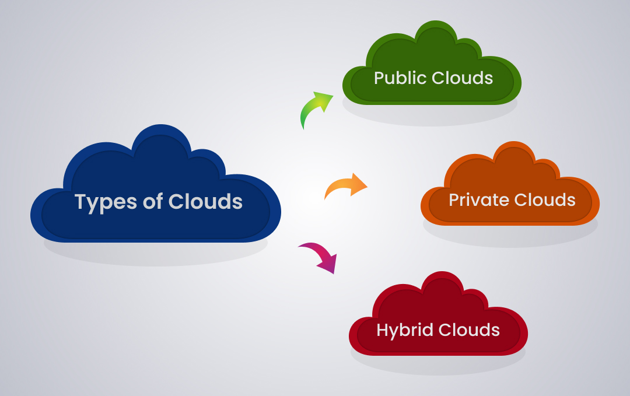
Types of Clouds
Public Cloud : Computing services offered by third-party providers over the public Internet. Customers to pay only per usage.
Private Cloud : All hardware and software resources are dedicated exclusively to, and accessible only by, a single customer. benefits include elasticity, scalability and ease of service delivery—with the access control, security and resource customization of on-premises infrastructure
Hybrid Cloud : A hybrid is a computing environment that combines an on-premises datacenter with a public cloud, allowing data and applications to be shared between them

Slide 6
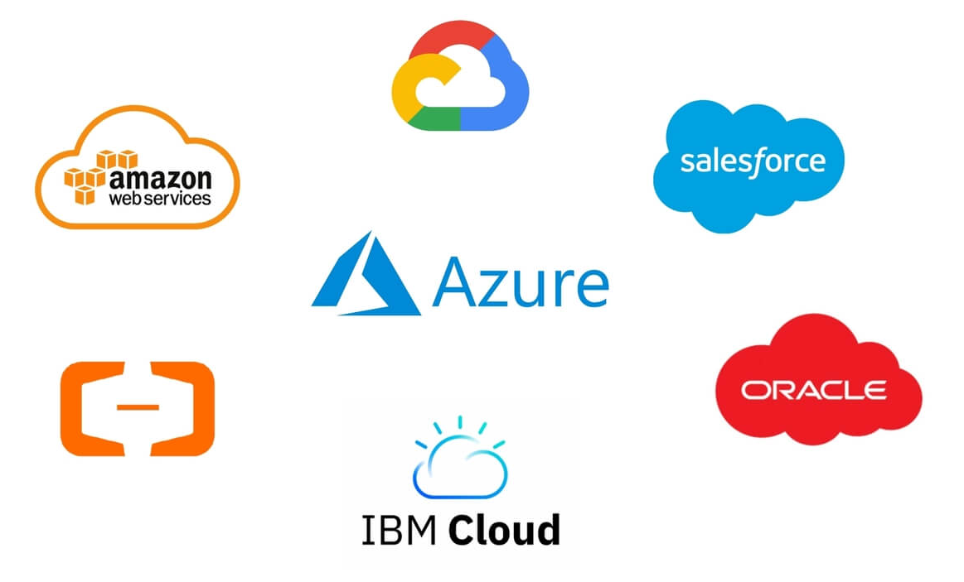
Major Cloud Providers

Slide 7
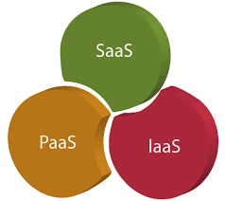
Cloud Service Models
IaaS : Infrastructure as a Service. Provides fundamental computing resources like servers, storage, and networking. Example – AWS EC2, Google Compute Engine
PaaS : Platform as a Service. Offers a development and deployment environment for applications. Example - Heroku, Google App Engine
SaaS : Software as a Service. Cloud-based method of delivering software where users subscribe to access applications on the Internet. Example – Salesforce, Google Works

Slide 8
Conclusion
Cloud computing offers scalable, flexible, and cost-effective IT solutions.
Different cloud models (public, private, hybrid) cater to diverse needs.
Service models (IaaS, PaaS, SaaS) provide varying levels of abstraction.
Major cloud providers offer a wide range of services and tools.
The future of cloud computing is bright, with advancements in AI, IoT, and edge computing.

Slide 9
Thank You 1

